Slide 1
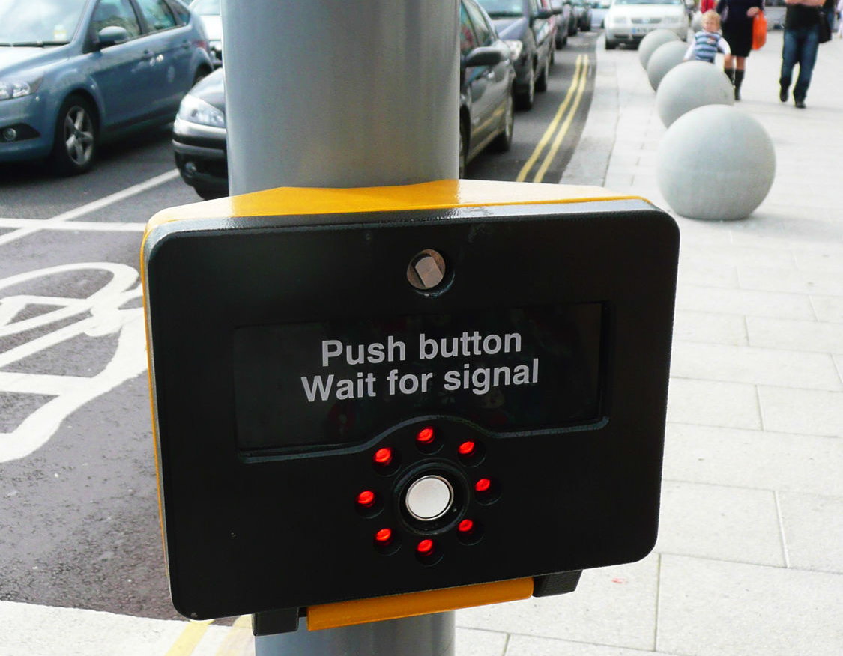
Interaction Design Principles and Usability

Slide 2
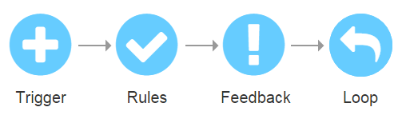
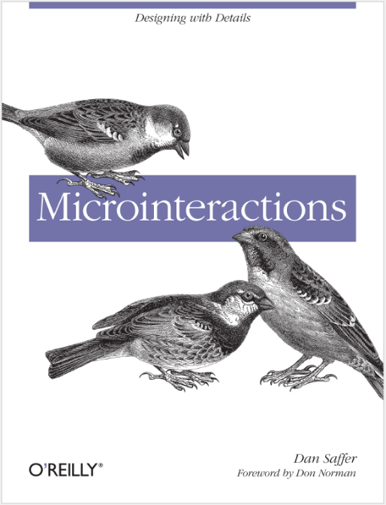
What’s Interaction?

Slide 3
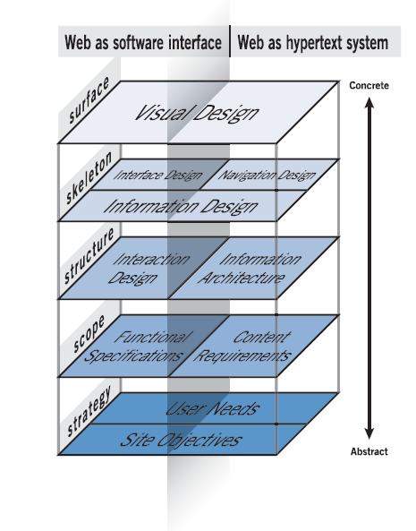
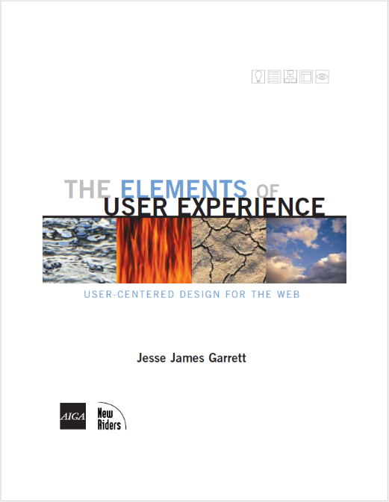
What’s Interaction Design?

Slide 4
IA vs. IxD
Information
Structure
Systems, taxonomies
Organization of information
Goals
Behavior
Tasks, actions, process flows
Process of exploration

Slide 5
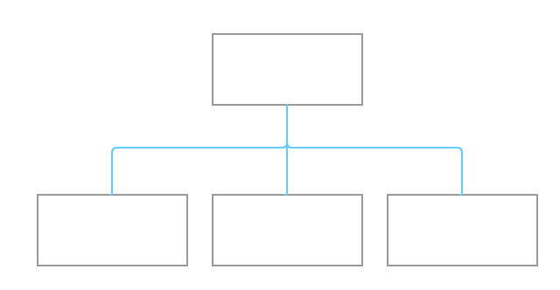
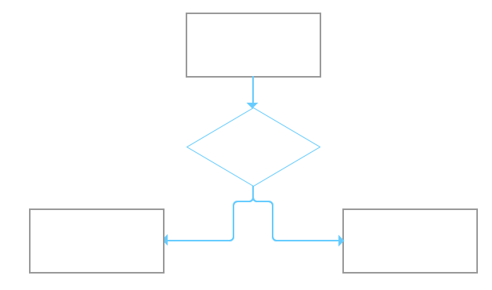
IA vs. IxD
Sitemaps
Workflows

Slide 6

What’s Interaction Design?
Development of application flows to facilitate user tasks defining how the user interacts with the site functionality. Through interaction design we define how the system behaves in response to the user.
JESSE JAMES GARRETT
IxD deals with user actions leading to certain reactions from the device or application they are working on to complete a specific task or achieve a certain goal.

Slide 7
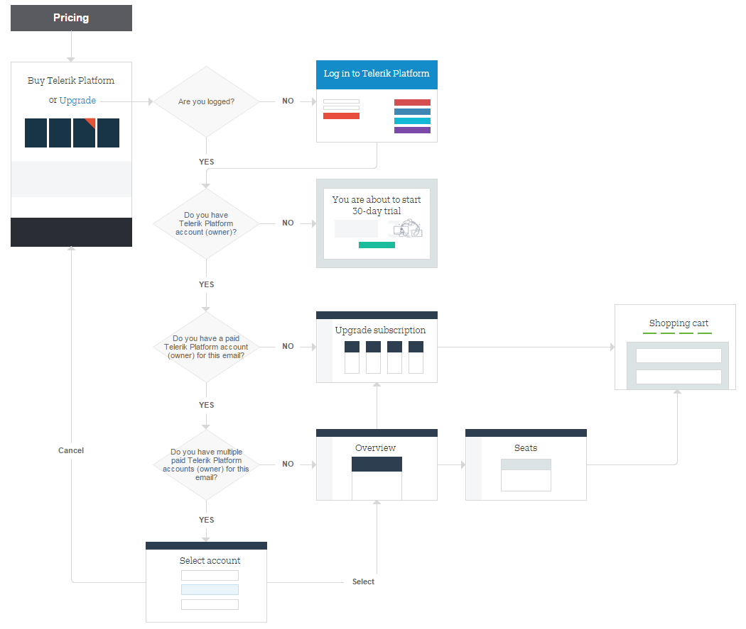
Does It Look Like This?

Slide 8
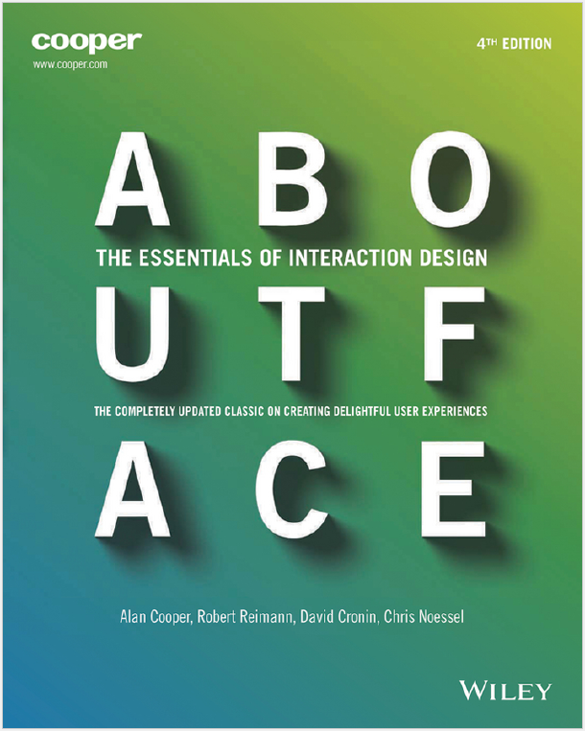
IxD Principles
Conceptual principles
Define what digital products should be like and how they fit structurally into the broad context of use required by their users.
Behavioral (functional) principles
Describe how a product should behave—in general and in specific contexts.
Interface-level principles
Describe effective strategies for the organization,
navigation, and communication of behavior and information.

Slide 9
IxD Principles
What
Conceptual principles
Functional principles
Interface-level principles
Who
Why
Where
When
How

Slide 10
Conceptual Interaction Design
Application goals
Target persona
Content and messaging
Context of use

Slide 11
Conceptual Interaction Design
1. Application goals
What’s the purpose of your application
What problems does it solve, what needs does it address
What’s the business value of your application - what do you want to achieve by designing it
What’s the users’ benefits of your application – why would anyone use it, what incentives do you offer
Do you have competition, how is your application different than the competition, what are you advantages
How do you measure your application success
Good design is good business.
THOMAS WATSON, JR.

Slide 12
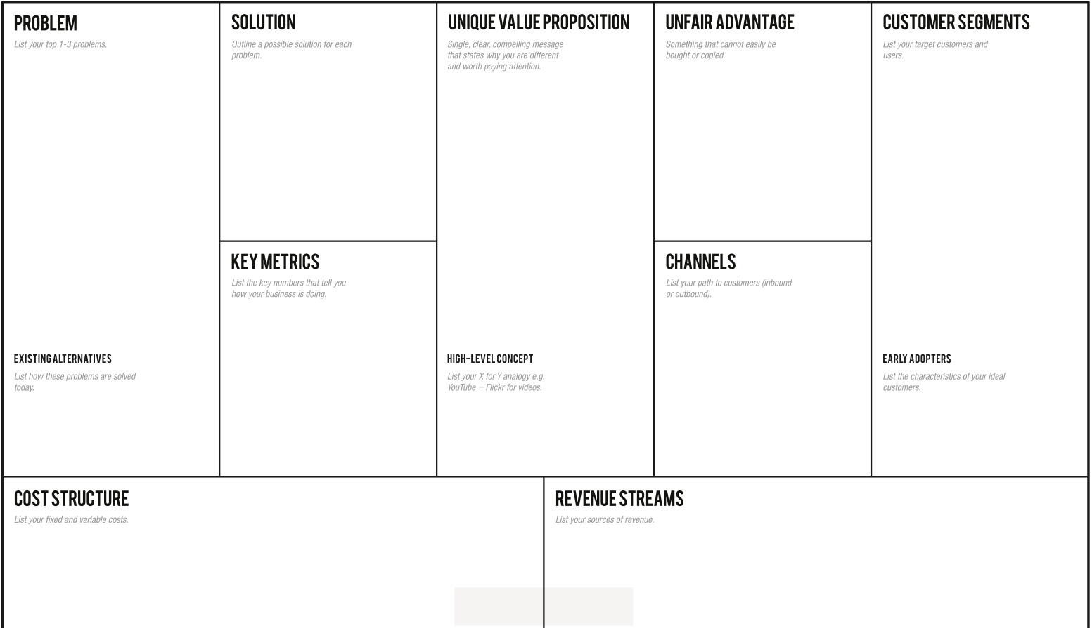
Lean Canvas Example

Slide 13
Conceptual Interaction Design
2. Target user
Who are your users
Who’s your primary persona, secondary personas
What are their needs, drivers, pain-points
What are your users’ demographics – age, sex, region, occupation, etc.
What are their attitudes and expectations
What is their experience – newbies, power-users
Design for somebody, alienate nobody.
PAUL BOAG

Slide 14
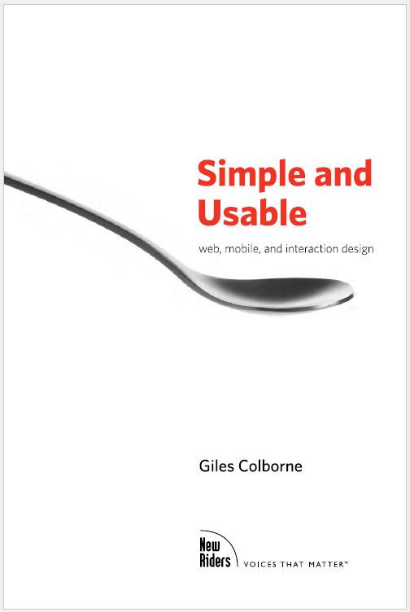
Conceptual Interaction Design
User types according to their approach
Experts
Willing adopters
Mainstreamers
Experts
Happy to explore new products. Want feature-rich never-before-seen technology that is customized for them.
Willing adopters
Already use similar products. Tempted to use something more sophisticated, but need to be given easy ways to adopt new features.
Mainstreamers
Don’t use technology for its own sake; Tend to learn a few key features and rarely add to their repertoire.

Slide 15
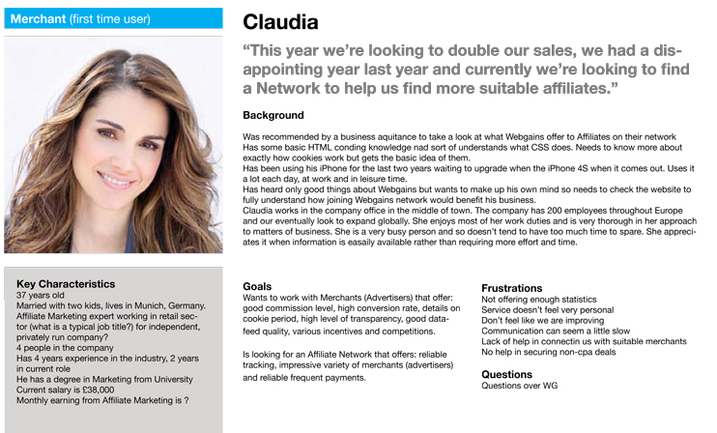
Persona Example

Slide 16
Conceptual Interaction Design
3. Content and messaging
What is the message your application convey
What content do you present – topics and genres (articles, photos, products, etc.)
Do you use the proper language - with words, phrases and concepts familiar to the user
Content is king!
BILL GATES
Content precedes design. Design in the absence of content is not design, it's decoration.
JEFFREY ZELDMAN

Slide 17

Messaging Example

Slide 18
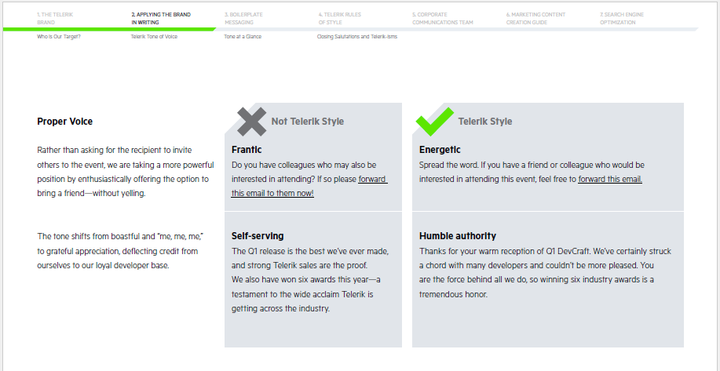
Content Guide Example

Slide 19
Conceptual Interaction Design
4. Context of use
Where is your application used
What’s users’ location when using it – home, office, outside, etc.
Is it used for professional purposes or for leisure
What device will be used to access your application – desktop, mobile, wearables, kiosks, smart tv, game console, etc. One or multiple devices.
If content is king, context must be the kingdom.
ERIC REISS

Slide 20
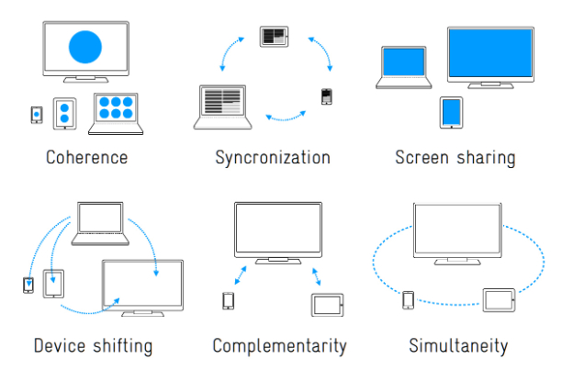
Multi-Device Usage Examples

Slide 21
Functional Interaction Design
User scenarios
User stories
Use cases
Workflows
Wireframes and low-fidelity prototypes

Slide 22
Functional Interaction Design
1. User scenarios
A narrative for the interactions between a user and the application towards achieving a certain goal. Describe the context and steps, events, and/or actions which occur during the interaction. If personas are the characters – the user scenarios are the plot.
Example scenarios:
Downloading a trial
Purchasing a product
Contacting support

Slide 23
Functional Interaction Design
2. User stories
A high-level definition of a requirement in agile software development methodologies. Contains one or more sentences in the everyday or business language of the end user that captures what the user wants to achieve.
"As a <role>, I want <goal/desire> so that <benefit> (optional)“
“As a license holder, I want to be able to change my billing/shipping addresses through Your Account, so that I receive my invoices at the right address.”

Slide 24
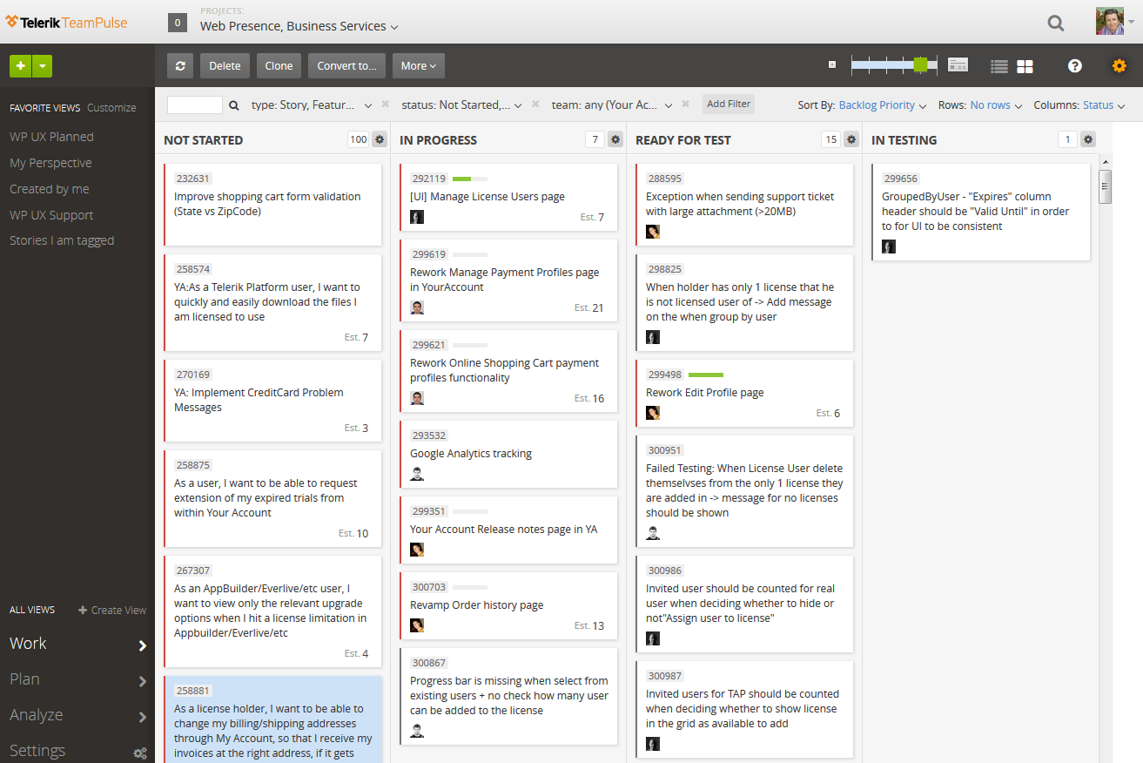
User Stores Example

Slide 25
Functional Interaction Design
3. Use Cases
Describes the behavior you need to build into the software to meet user’s needs from the user story. It is detailed, clear and unambiguous. It may have pre-conditions and post-conditions. One user story can have many use-cases.
Happy path / Sunny day cases
Alternative paths
Exceptions
Edge cases

Slide 26
Functional Interaction Design
4. Workflows
Workflow in interaction design is the series of activities that are necessary to complete a task.
Easy way to visualize the process described in the user scenario, user stories and use cases.

Slide 27
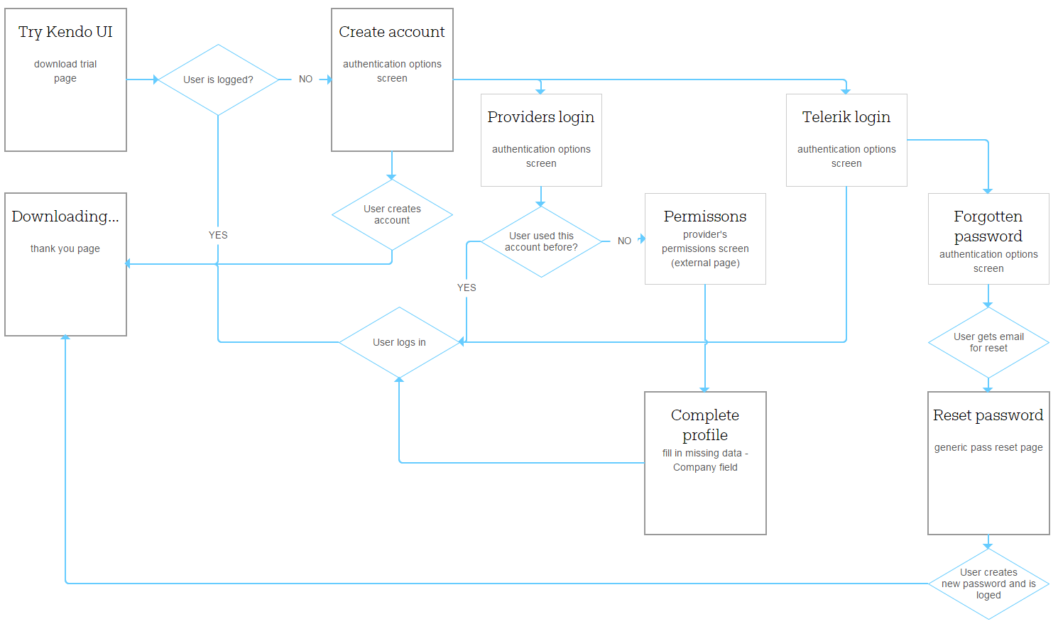
Workflow Example

Slide 28
Functional Interaction Design
5. Wireframes and low-fidelity prototypes
Wireframes are a quick way to arrange a webpage or interface layout.
Easy way to present basics of your concept, to prioritize features and content.
When linked into a clickable prototype they communicate and validate the logic, sequence and relations between pages or interface screens.

Slide 29
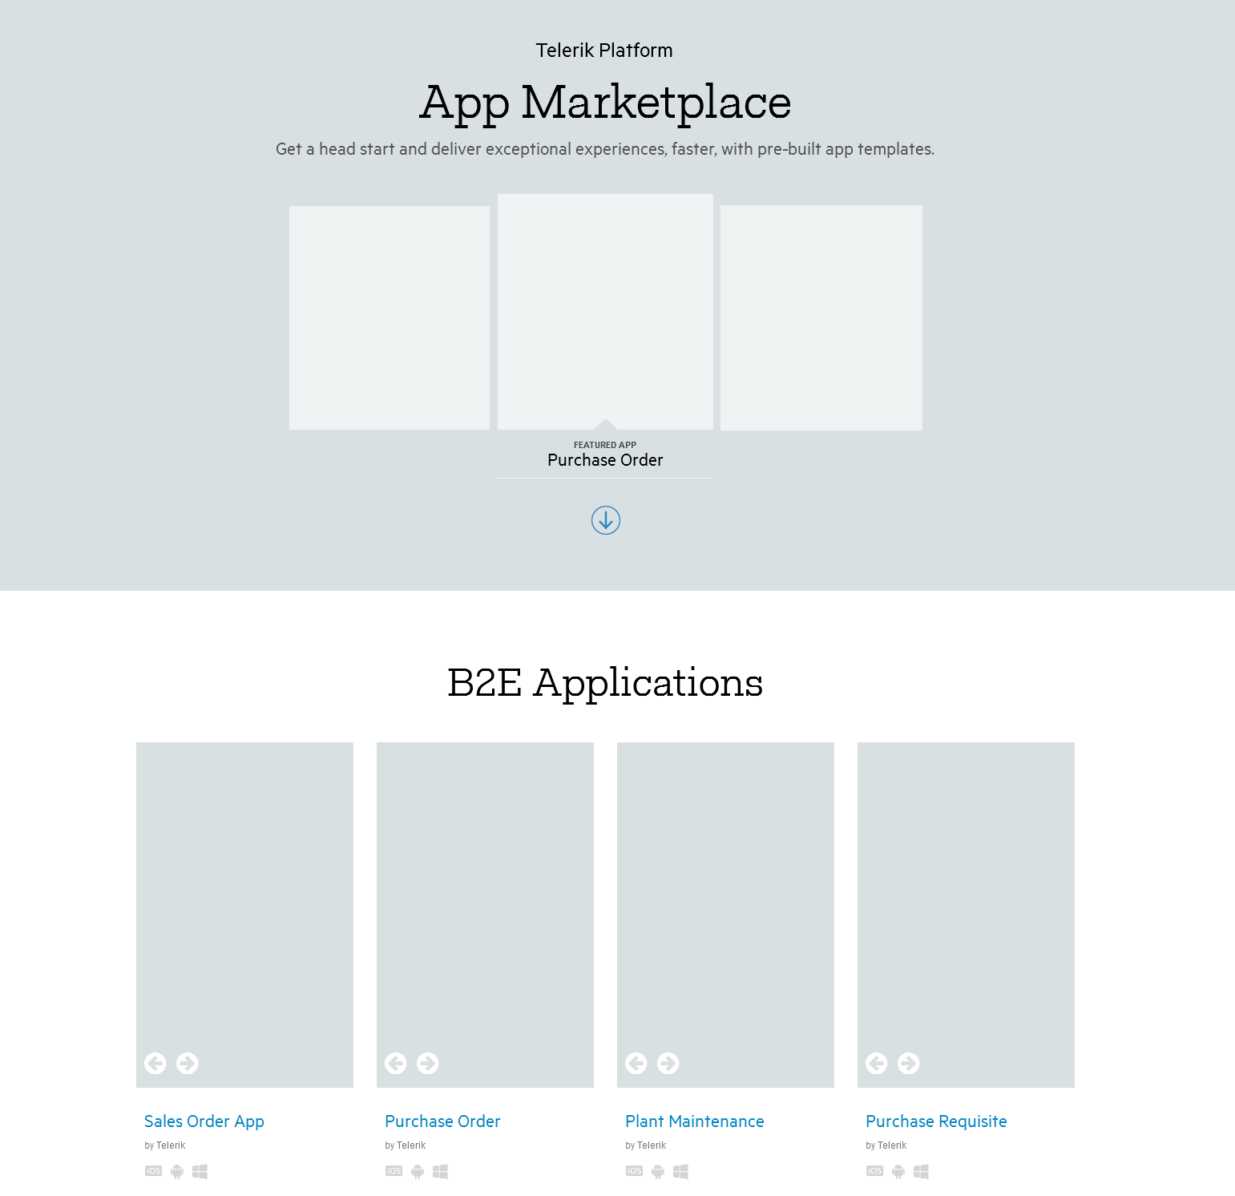
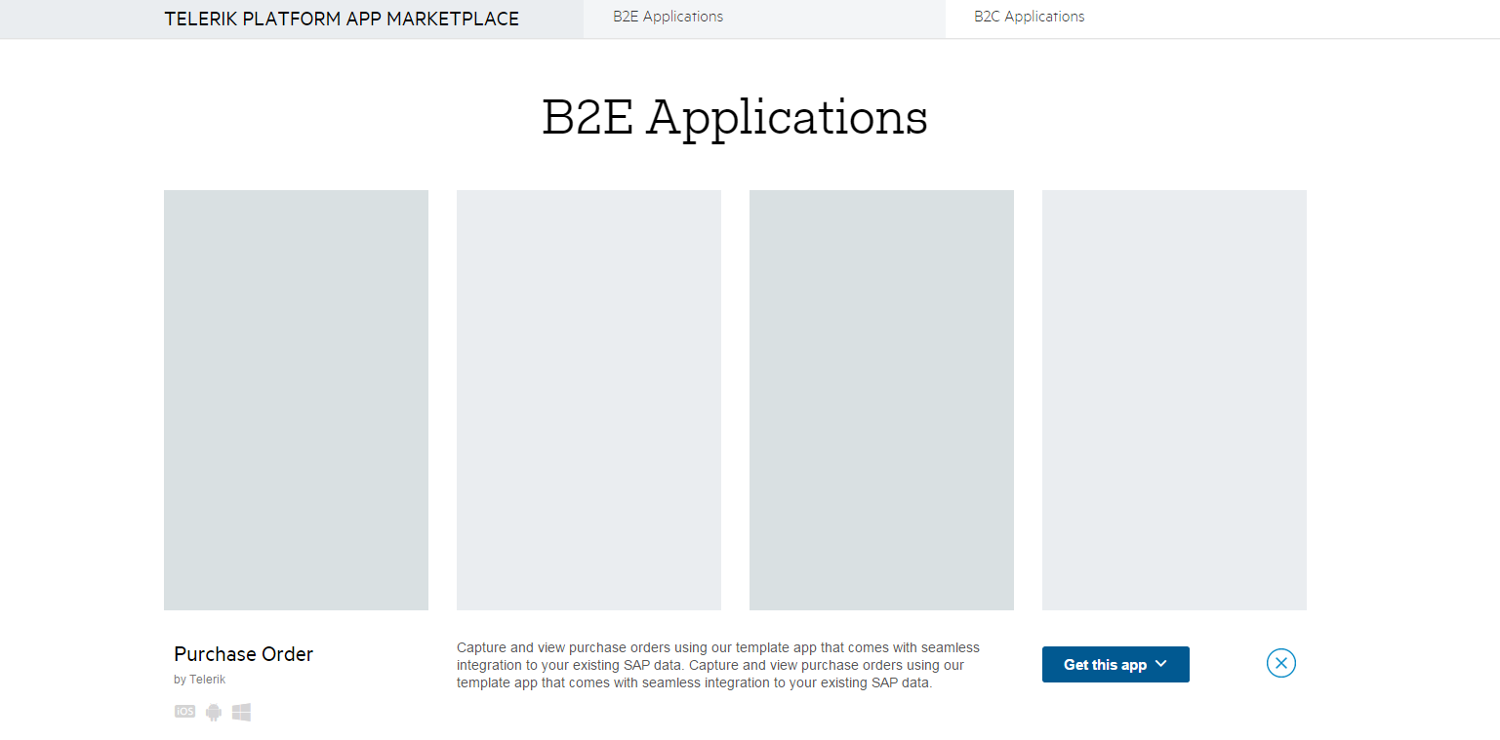
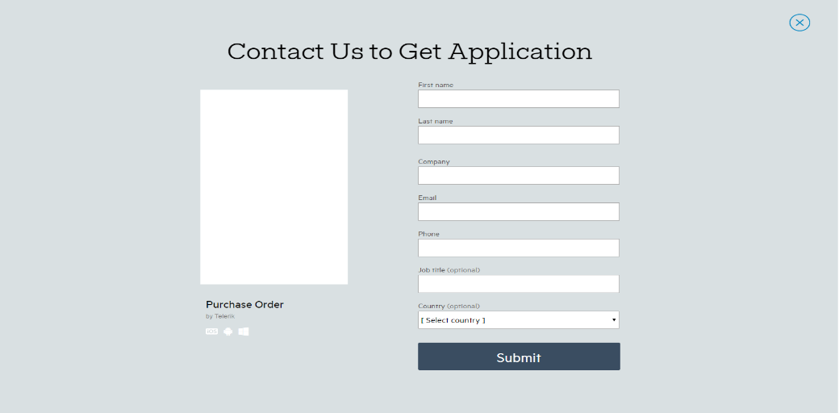
Wireframes Example

Slide 30
Interface-Level Interaction Design
Input tools
Navigation types
Interface organization and UI patterns
High-fidelity designs and interactive prototypes

Slide 31
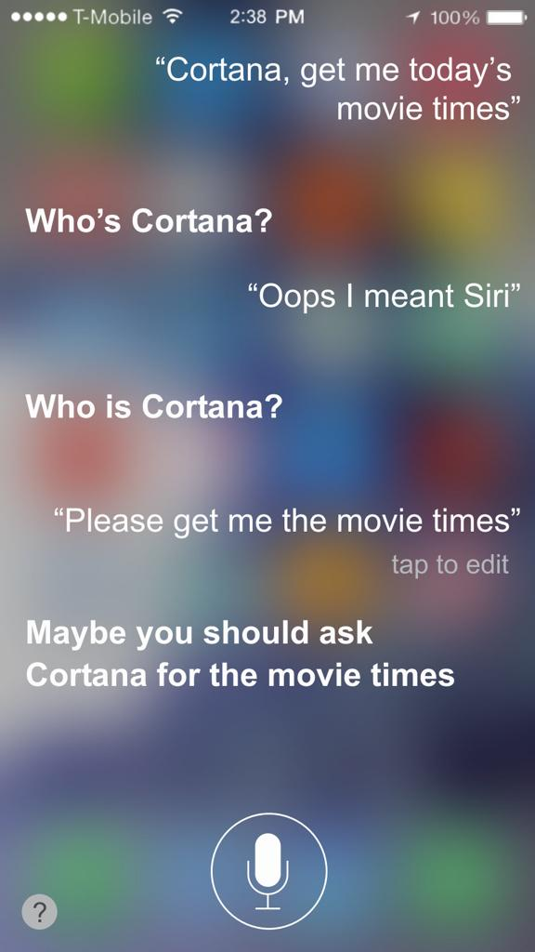
Interface-Level Interaction Design
1. Input tools
Mouse
Keyboard
Voice
Stylus
Touch
Remote control
Joystick
Other technologies

Slide 32
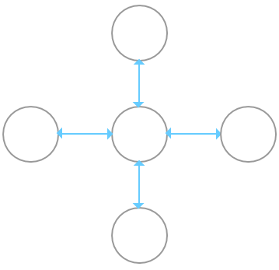
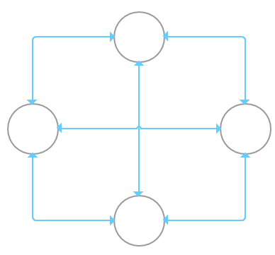
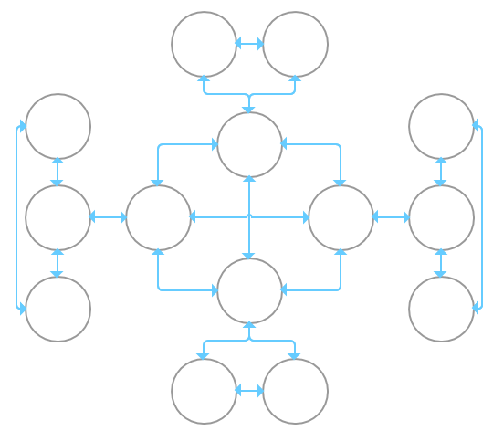
Interface-Level Interaction Design
2. Navigation types
Hub and spoke
Fully connected
Multi-level

Slide 33
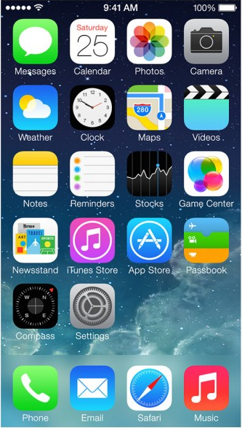
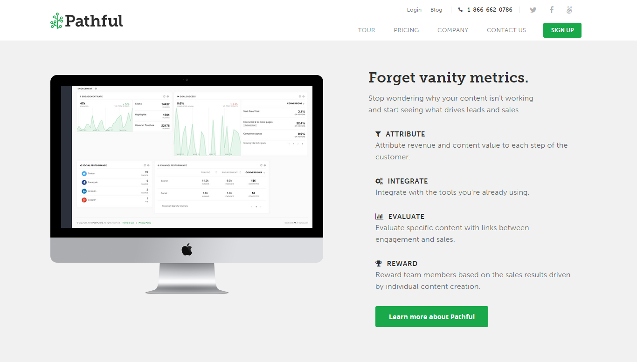
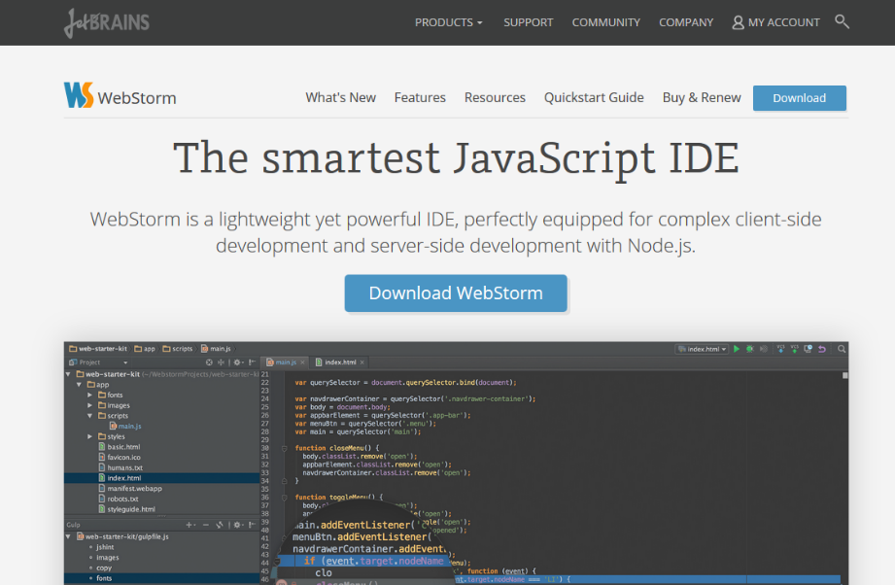
Interface-Level Interaction Design
2. Navigation types
Hub and spoke
Fully connected
Multi-level

Slide 34
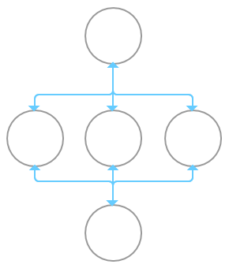
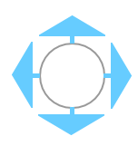
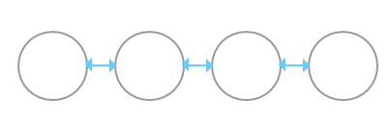
Interface-Level Interaction Design
2. Navigation types
Facets
Step-wise
Pan and zoom

Slide 35
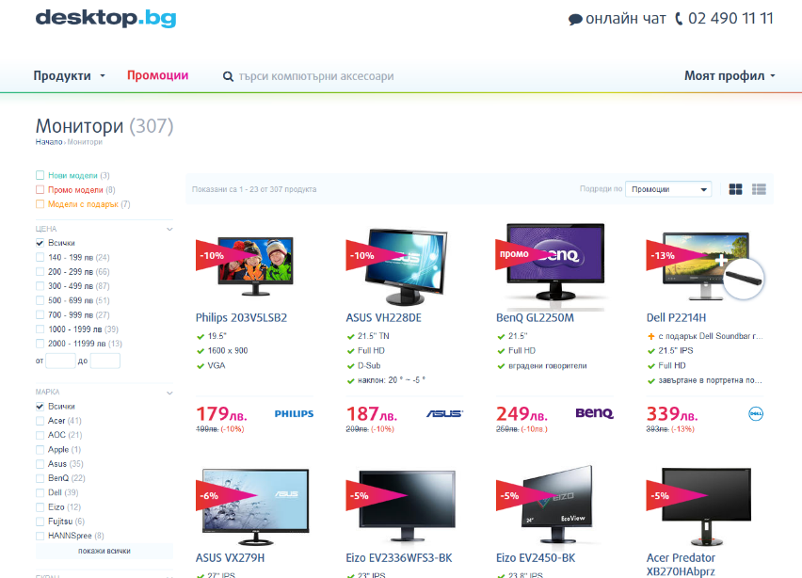
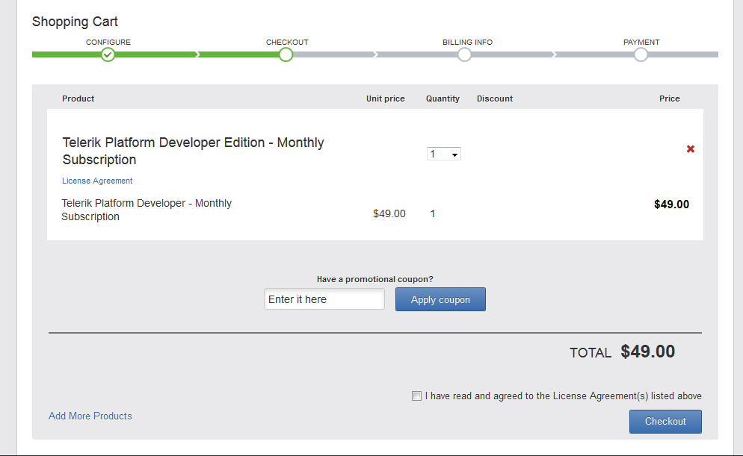
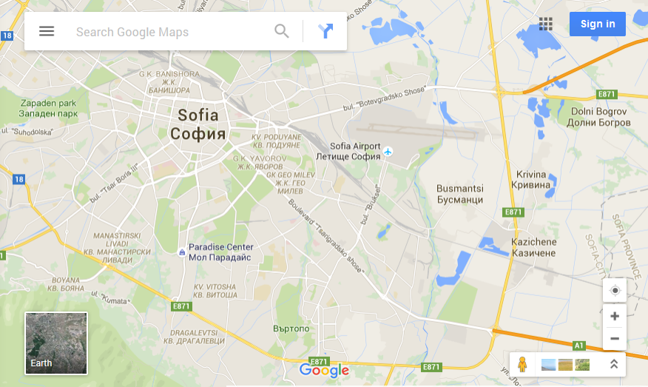
Interface-Level Interaction Design
2. Navigation types
Facets
Step-wise
Pan and zoom

Slide 36
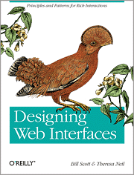
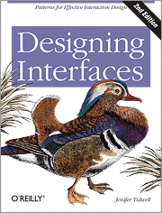

Interface-Level Interaction Design
3. Interface organization and UI patterns
Learn about them in the UI Design lecture
Useful books for UI patterns
Designing Web Interfaces: Principles and Patterns for Rich Interactions (By Bill Scott, Theresa Neil)
Designing Interfaces (By Jenifer Tidwell)
Mobile Design Pattern Gallery (By Theresa Neil)
Pattern libraries
Collection of user interface design patterns and components, that you use in your application.
May include rules for their use for specific cases. Help to maintain consistency of the interface.

Slide 37
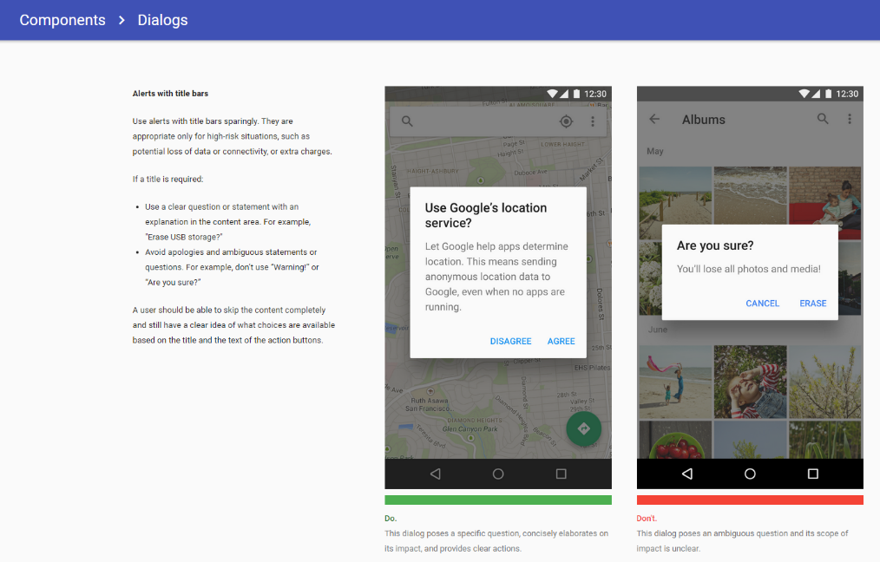
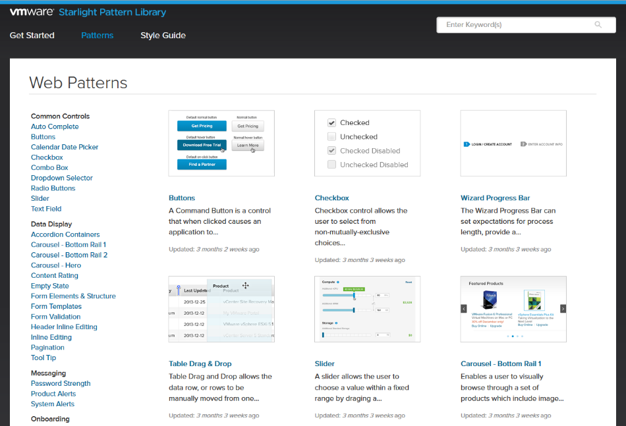
Pattern Libraries Examples

Slide 38
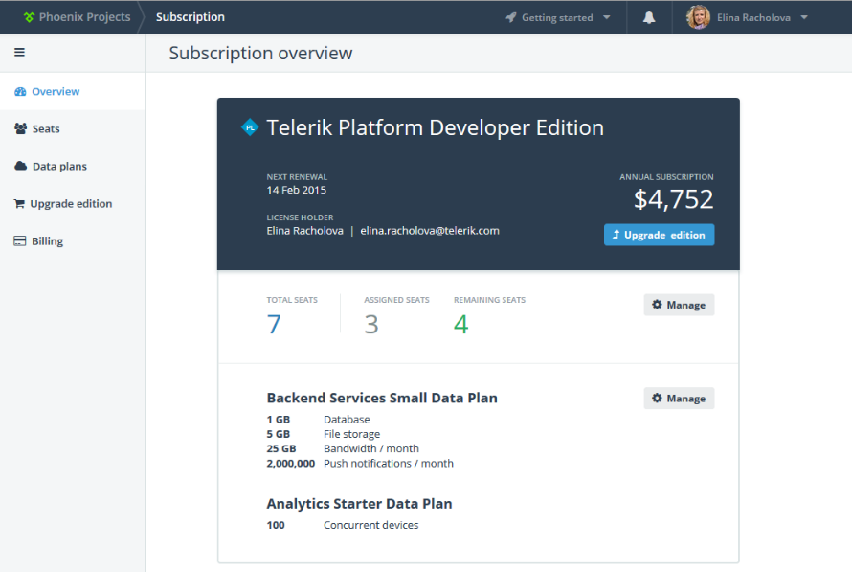
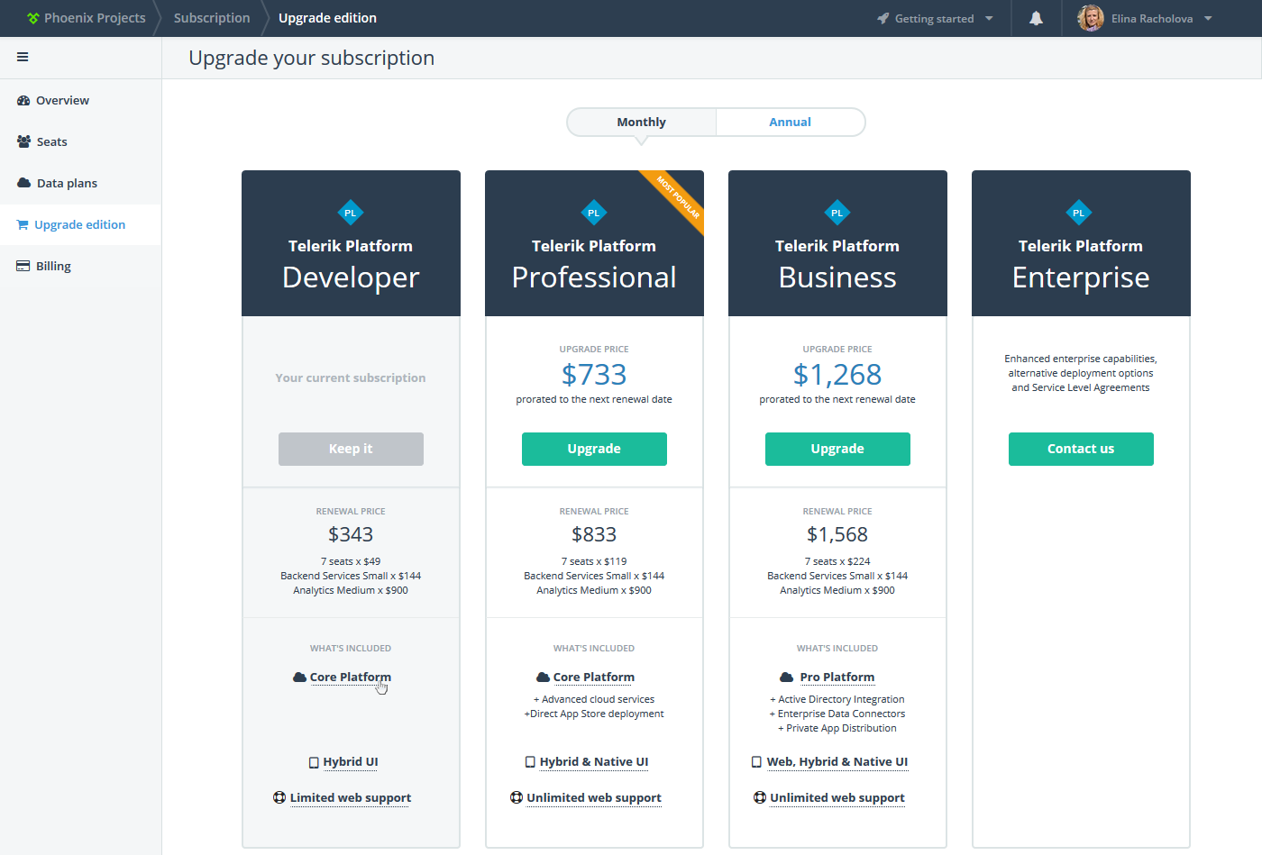
Interface-Level Interaction Design
4. High-fidelity designs and interactive prototypes
Learn more about design in the Graphic design lecture
Interactive prototypes
Linked together high-fidelity screens that may incorporate many functional details and use-cases, may include the visual design. Can be tested with users to discover issues in terms of navigation, functionality, logic, content messaging, etc.
Can be used as proof-of-concept, or serve as a specification for developers.

Slide 39
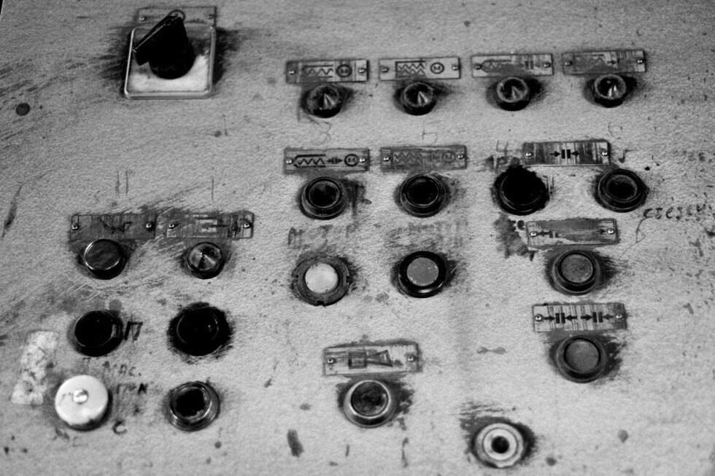
Intuitive Design

Slide 40
Intuitive Design
Mental model vs. Concept model
Representation of a device or software that a person has in mind before they even use it.
People use it to predict how the system behaves.
Comes from prior experience with similar software or devices, assumptions they have, things they’ve heard others say.
Not everyone has the same mental model.
Mental models are subject to change.
Actual model that is given to the person through the design and interface of the actual product.
If there is a mismatch between the person’s mental model and the product’s conceptual model, then the product will be hard to learn, hard to use, or not accepted.
Concept model should match the persona you are designing for.
Concept model matching the mental model makes the design intuitive.
Use the Principle of least surprise - users interacting with applications have certain expectations and should not be surprised with the way application is working.

Slide 41
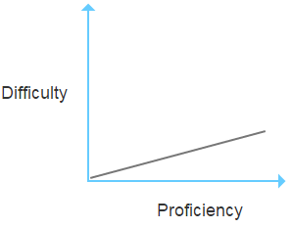
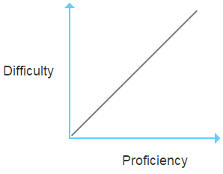
Intuitive Design
Learning Curve
Graphical representation of how hard it is to acquire proficiency.
Intuitive products and websites have a shallow learning curve.
Specialized software can have a steep learning curve, but still be usable. After proficiency comes efficiency and sometimes shallow learning curve and efficiency cannot be reconciled.
Hard to learn
Usable

Slide 42
What about Usability?
3 stages of implementing usability
Nobody is talking about usability
Everybody is talking about usability
Nobody is talking about usability
Smart Design
Work
+
Good Engineering Execution
=
Usability is a result of the team effort for proper implementation of interaction design principles.
Usable Product

Slide 43

Usability Principles
Jakob Nielsen's 10 Usability Heuristics
Visibility of system status
Match between system and the real world
User control and freedom
Consistency and standards
Error prevention
Recognition rather than recall
Flexibility and efficiency of use
Aesthetic and minimalist design
Help users recognize, diagnose, and recover from errors
Help and documentation
http://www.nngroup.com/articles/ten-usability-heuristics/

Slide 44
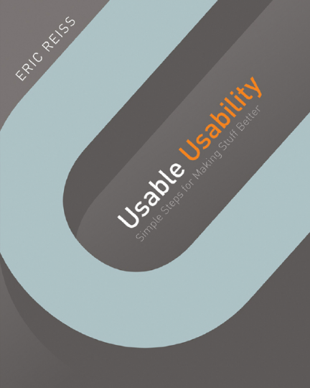
Usability Principles
Usability Principles by Eric Reiss
1. Ease of Use
Functional (it actually works)
Responsive (I know it’s working; it knows where it’s working)
Ergonomic (I can easily see, click, poke, twist, and turn stuff)
Convenient (everything is right where I need it)
Foolproof (the designer helps me to not make mistakes or break stuff)
2. Elegance and Clarity
Visible (I can actually see stuff)
Understandable (I know what I’m looking at and get how it works)
Logical (the stuff I see and the procedures I am asked to follow make sense)
Consistent (the rules of the game won’t change on me unexpectedly)
Predictable (when I do something, I have a clear idea what’s going to happen next)

Slide 45
How to Get There?
Orientation
Guidance
Efficiency
Error Handling

Slide 46
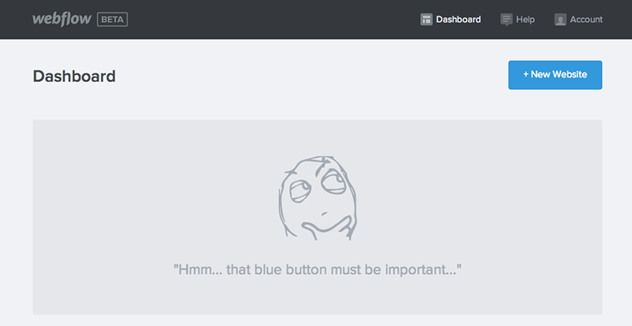
Orientation
Affordance
Information scent
Feedback
Interaction states

Slide 47
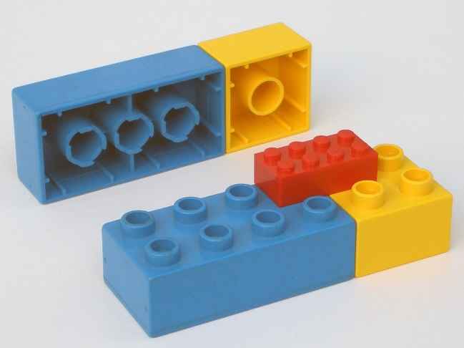
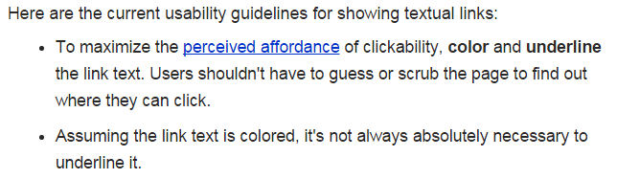
Orientation
Affordance
Property in which the sensory characteristics of an object imply its functionality and use. There are natural and perceived affordance.
The term "perceived affordance" (forged by Don Norman) applies when the object properties are perceived in a way that differs from the real-world physical properties.
Depends on the context - environment in which the element is displayed, and the user’s mental model – previous experience and expectations of interaction.
Use traditional signifiers and contextual clues.

Slide 48
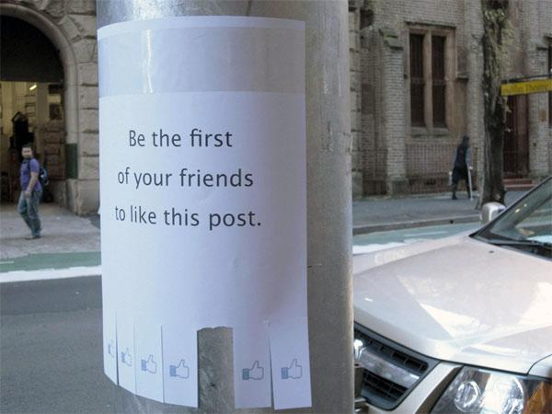
Affordance Example

Slide 49
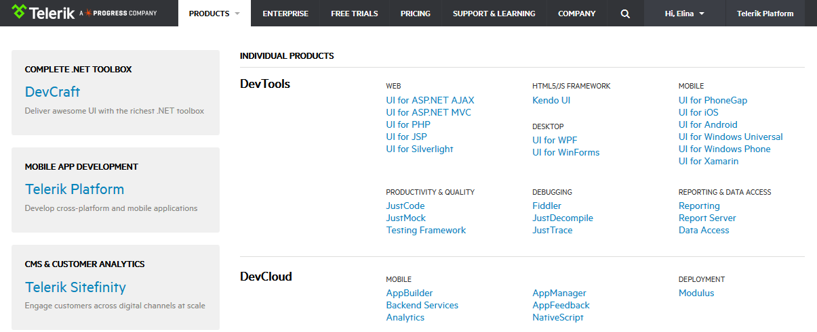
Orientation
2. Information scent
Information scent refers to the extent to which users can predict what they will find if they pursue a certain path through a website or application.
Use clear labels and microcopy.

Slide 50
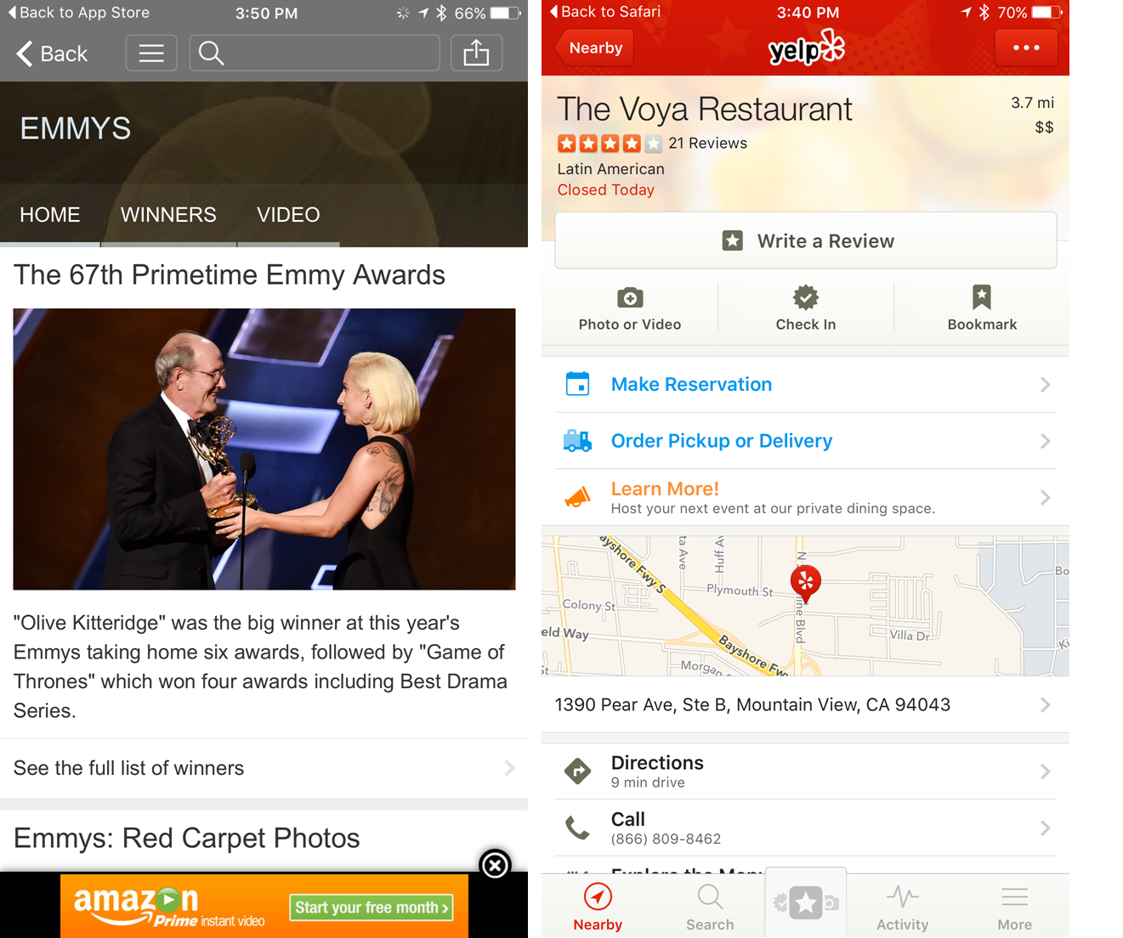
Information Scent Examples

Slide 51
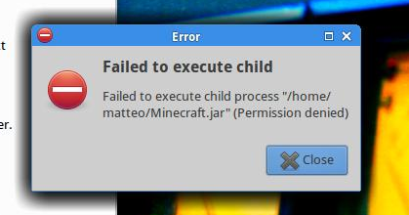
Orientation
3. Feedback
Feedback makes the results of an interaction visible. Feedback is when an object is giving you a signal that:
Is still performing a task
Will perform a task for a certain time to its completion
Has succeeded performing a task
Failed at performing a task
Feedback answers questions across 4 categories:
Location: Where am I?
Current Status: What’s happening – and is it still happening?
Future Status: What will happen next?
Outcomes: What just happened?

Slide 52
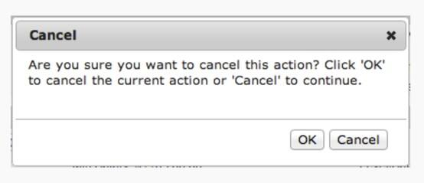
Labels and Microcopy Went Wrong

Slide 53


Orientation
4. Interaction states
All transitions/events an interface element goes through during user’s operation with it.
Default – Selected
Active – Inactive
On hover – On mouse/key down
Other – blank (empty) state; visited; on drag; on focus; etc.

Slide 54



Real Life Blank State Examples

Slide 55

Blank State Examples

Slide 56

Guidance
Paradox of the active user
Clear entry points
Onboarding
Primary actions
Progressive disclosure

Slide 57

Guidance
Paradox of the active user
Users never read manuals but start using the software immediately.
Motivated to get started and to get their immediate task done.
Don't care about the system as such and don't want to spend time to set up or learning.
It is a paradox because users would save time in the long term by taking some initial time to optimize the system and learn more about it.

Slide 58

Guidance
2. Clear entry points
Give people a set of clear entry points into the application or website based on their most common tasks or destinations.
“Doors" into the main content of the site or application.
Useful when a significant number of users will be first time users or infrequent users.

Slide 59


Clear Entry Points Examples

Slide 60

Guidance
3. Onboarding
That process of helping people get started.
Welcome experiences for new users to ease them to explore and know your application.
Most commonly limited to a first-time use scenario.
Present the key benefits of using the application or teach the app’s main features so new users can use it immediately.
Popular techniques: tutorial (at the start); walkthrough (sequential steps); coachmarks (contextual help);

Slide 61


Onboarding Examples

Slide 62

Guidance
4. Primary action
Having an obvious target action that makes sense for most people most of the time both reinforces a sense of the goal that people are working towards and makes it easy to take action to accomplish that goal.
Useful when there are multiple possible commands within a given view.
Increase the likelihood that they will choose the right action for a given context.

Slide 63


Primary Action Examples

Slide 64


Guidance
5. Progressive disclosure
All of the information that the user may need to see during the complete process may seem overwhelming if shown initially.
Information or sub-tasks should be provided to users in a step-by-step manner – only when needed – and may differ based on responses or interactions during previous steps.
Helps maintain the focus of a user's attention by reducing clutter, confusion, and cognitive workload.
Improves usability by presenting only the minimum data required for the task at hand.
Defers advanced or rarely used features to a secondary screen, making applications easier to learn and less error-prone.

Slide 65


Progressive Disclosure Examples

Slide 66

Efficiency
Interaction cost
Recognition vs. recall
Sequence, flow and interruption
Good defaults
Customization
Perceived performance

Slide 67

Efficiency
1. Interaction cost
The sum of efforts — mental and physical — that the users must deploy in interacting with a site in order to reach their goals.
Direct measure of usability – the lower the cost, the more usable the app is.
Usable applications minimize the interaction cost required to attain a variety of user goals. That is, they minimize:
reading
scrolling
looking around in order to find relevant information
comprehending information presented to you
clicking or touching (without making mistakes)
typing
page loads and waiting times
attention switches
memory load ­– the information that users must remember in order to complete their task.

Slide 68
Efficiency
2. Recognition vs. recall
Recognition is easier than recall.
Recognition makes use of context. And context can help you remember.
Minimize the user's memory load by making objects, actions, and options visible.
The user should not have to remember information from one part of the dialogue to another.

Slide 69

Efficiency
3. Sequence, flow and interruption
Events occurring while exploring and using applications must occur in a logical sequence. Users must not zig-zag within and across pages or screens.
Interaction with the application should happen in a seamless flow. Users must have control over their actions during the activity. Any difficult parts should be broken into stages, so they are overcome quickly.
Any elements or events that distract users’ attention from their primary goals are disruptions and must be avoided or minimized.

Slide 70

Sequence and Flow Example

Slide 71

Efficiency
4. Good defaults
Wherever appropriate use to spare user’s work.
Prefill form fields with your best guesses at the values the user wants.
Land user on a screen that is most probable to start work from.
Use previous input, location detection, etc.

Slide 72


Good Defaults Examples

Slide 73

Efficiency
5. Customization
Customization happens when the users tells the application what they prefer to see or how to use certain features.
Personalization happens when the application modifies its behavior to suit its predictions about the current user's interests.
Consists of adapting interfaces and configuring functionality.

Slide 74

Customization Example

Slide 75

Efficiency
6. Perceived performance
Refers to how quickly an application feature appears to perform its task.
Performance is important for application usage, but it means less when the end users can actually sense the improvement.
The amount of time an application takes to start up, or a file to download, is not made faster by showing a startup screen or a file progress bar. It appears faster to the user as well as providing a visual cue to let them know the system is handling their request.

Slide 76

Perceived Performance Example

Slide 77

Error Handling
Error types
Error prevention

Slide 78

Error Handling
1. Error types – slips and mistakes
Slips occur when users intend to perform one action, but end up doing another (often similar) action. For example, typing an “i” instead of an “o” counts as a slip.
Typically made when users are on autopilot, and when they do not fully devote their attention resources to the task at hand.
Mistakes are made when users have goals that are inappropriate for the current problem or task.
Conscious errors that arise when a user has incomplete or incorrect information about the task, and develops a mental model that doesn’t match how the interface actually works.

Slide 79
Error Handling
1. Error types – according to the outcome
Errors with a positive consequence are actions that do not give the desired result, but provide the person with information that helps him or her achieve an overall goal.
Errors with a negative consequence are those that result in a dead end, undo a positive consequence, send the person back to a starting point, or result in action that cannot be reversed.
Errors with a neutral consequence are errors that have no effect on task completion.
Tunnel action - Tunnel action is where you keep doing the same task over and over, even though it isn’t working. Occurs more frequently when people are under stress.

Slide 80

Error Handling
2. Error prevention
Make careful design which prevents a problem from occurring in the first place.
Eliminate error-prone conditions and include helpful constraints.
Choose good defaults, so users have to do less to accomplish a task.
Use forgiving formatting for data input.
Preview results before commit.
Present users with a confirmation option before they commit to actions that may have destructive effect.
Warn before errors are made.
Provide options to recover.
Support “Undo” option - it’s a safety net that makes these errors less costly.

Slide 81


Error Prevention Examples

Slide 82

Thank You for
standing through
all that UX rubbish! ☺

